Slide 1
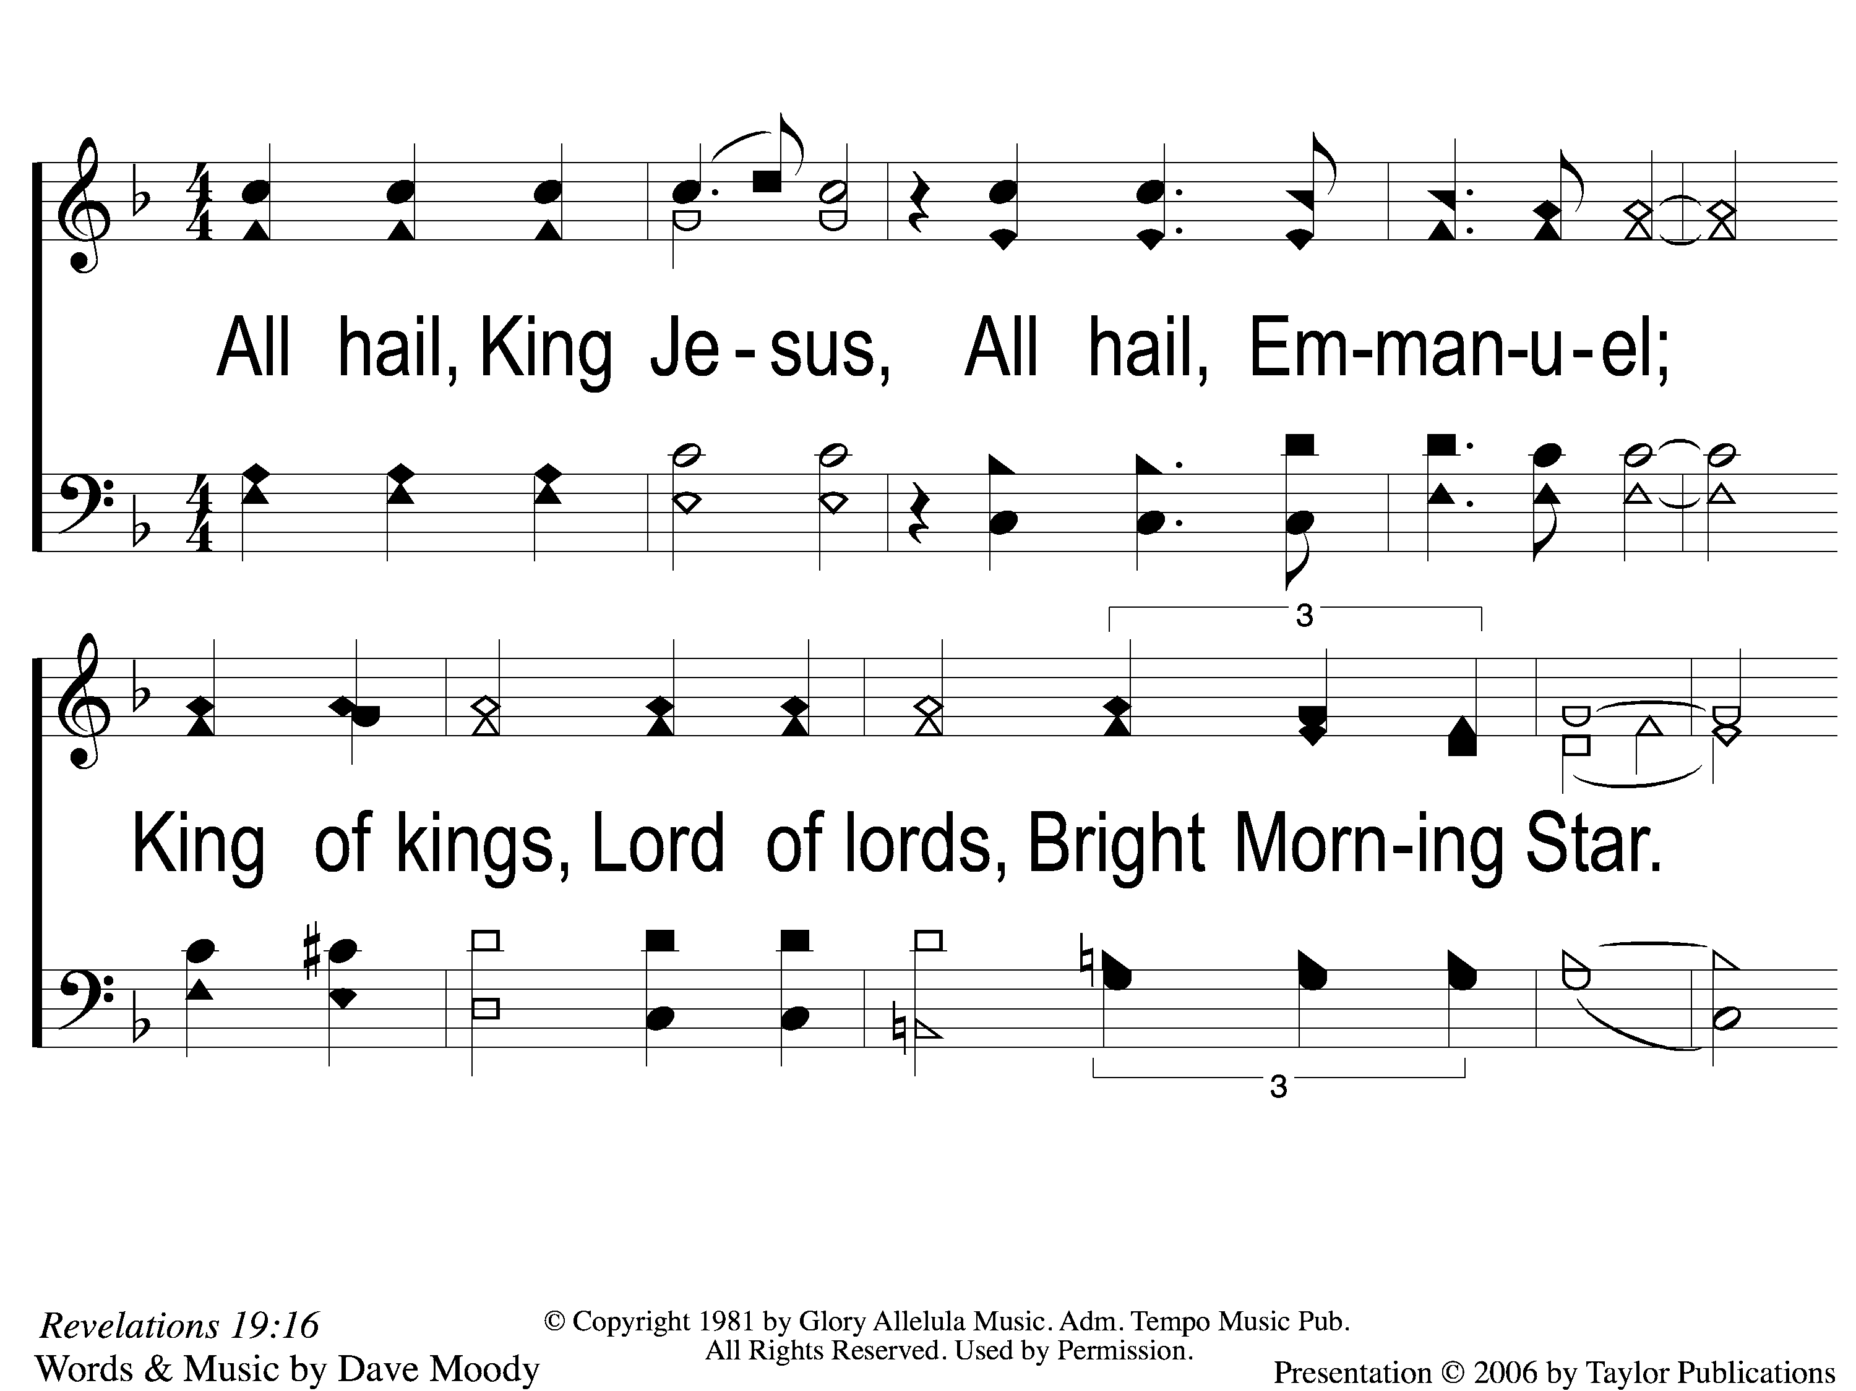
1 All Hail King Jesus
All Hail King Jesus
178

Slide 2
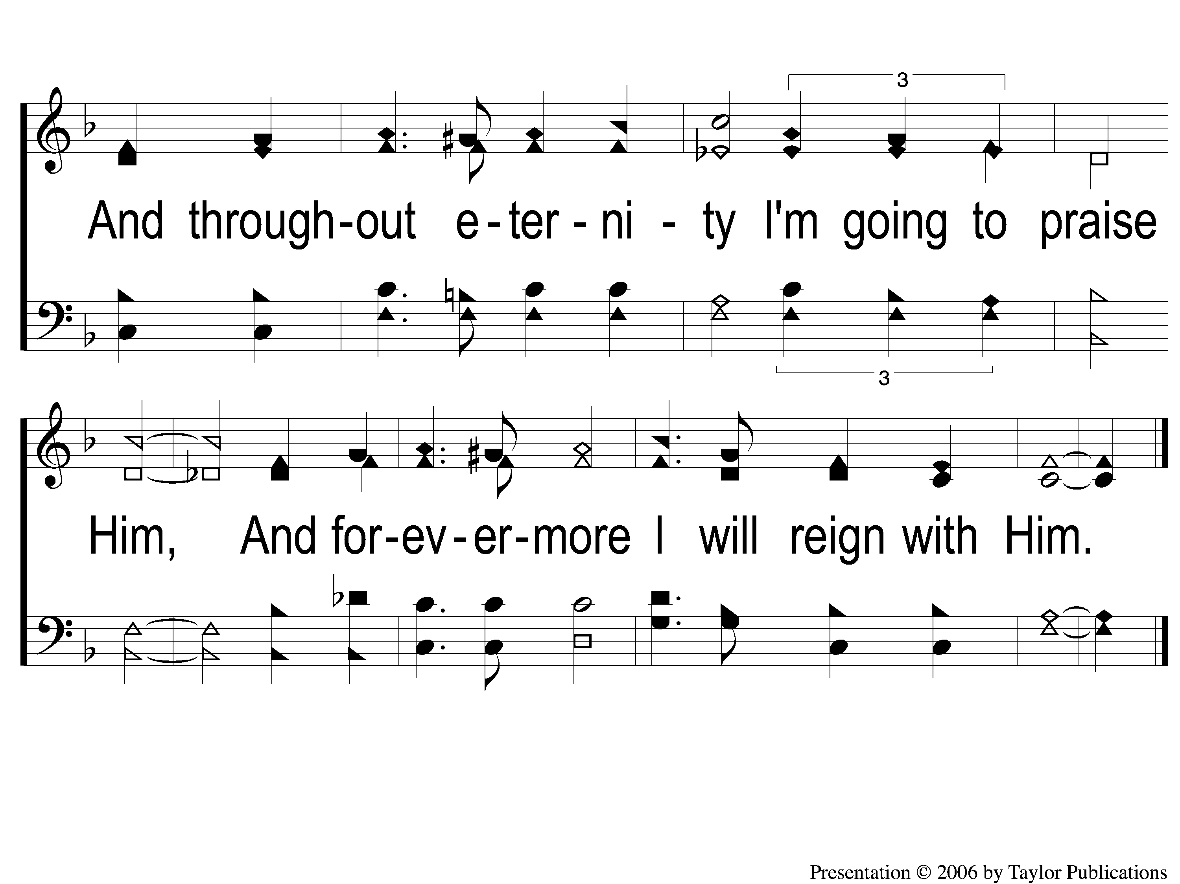
2 All Hail King Jesus
All Hail King Jesus
178

